Slide 1

Analysis Of Tweets
Deleted tweet or Legitimate tweet
Spring 2022

Slide 2
Dataset
Legitimate data
(755659,6)
Deleted data
(259533,6)
Attributes:
Author → String
Content → String (Text)
Is_retweet → Boolean
tweet_id → String
Following → Numerical
Followers → Numerical
Legitimate data
(3000,5)
Deleted data
(3000,5)
Is_retweet [‘True’] removed
Selected by random
Politician Authors

Slide 3
Preprocessing and preparing data
HTML decoding
‘@’mention
URL links
UTF-8 BOM (Byte Order Mark)
hashtag / numbers
lower_case
Clean Column

Slide 4
POS Tagging
NLTK library
Define POS function
Implement POS to deleted data and Legitimate data
Create one column for each POS tags (‘upenn_tagset.pickle’)
Do the frequency of POS for each row
Normalize frequency of POS tags for both dataset

Slide 5
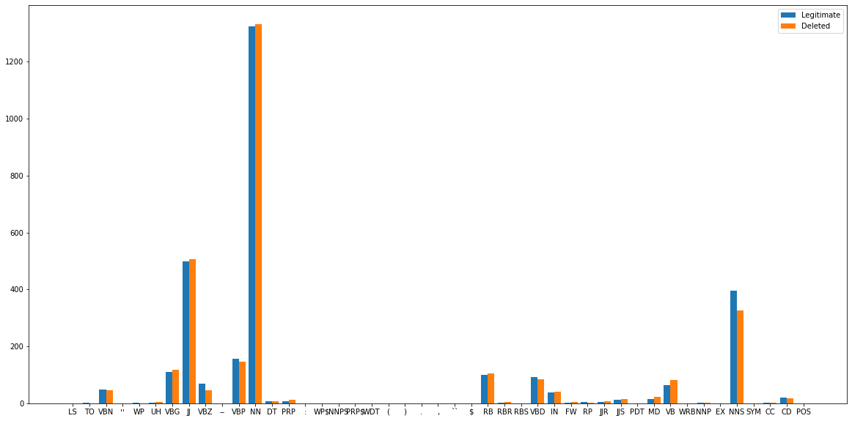
Statistics of POS Tags
Most common tags:
NN
2. JJ
3. NNS

Slide 6
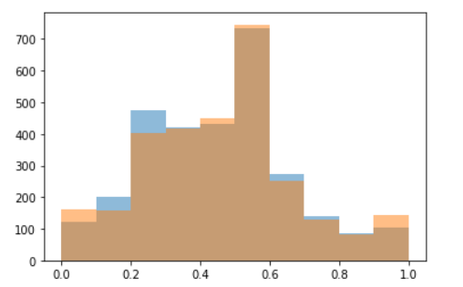
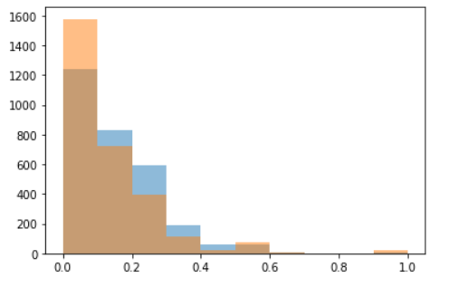
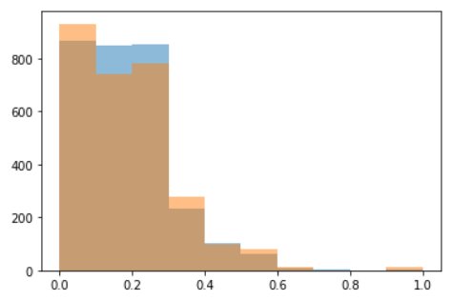
Histogram for most common POS tags
Frequency Of JJ
Frequency Of NN
Frequency Of NNS

Slide 7
Unigram and Bigram
nltk.ngrams
Define Unigram and Bigram functions and implement them to both datasets.
Gathered all the words in the dataset and created a library with the length of 7144 unique words for deleted data and 8579 unique word for legitimate data.
Create column for each word.
Calculate the frequency of each word in each row.
Normalize the frequency based on the length of each row.

Slide 8
Phrasal Tags
nltk.RegexpParser(grammar) # grammar for VP and Np
Define a function to apply phrasal tags
Implement Phrasal tags to both dataset
Create new columns of VP and NP
Calculate the frequency for VP and NP
Normalize the frequency of VP and NP

Slide 9
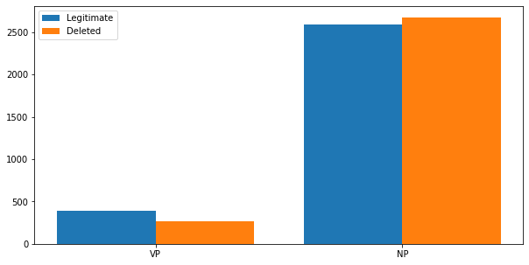
Bar Plot for Phrasal tags

Slide 10
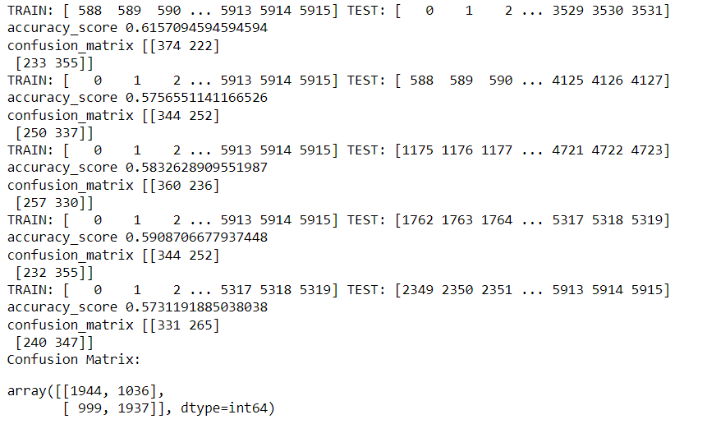
Gradient Boosting Classifier
learning_rate=0.1
max_depth= 5
max_features = 5
random_state = 42
Accuracy Score
~ 62

Slide 11
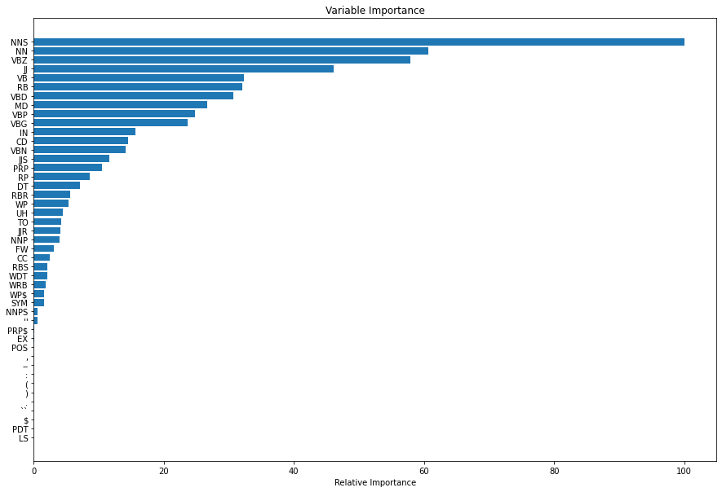
Feature Importance

Slide 12
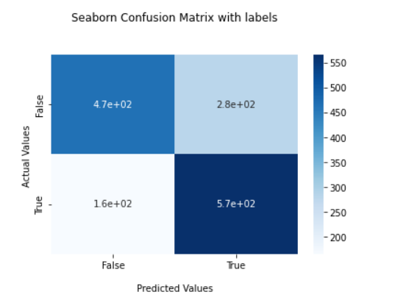

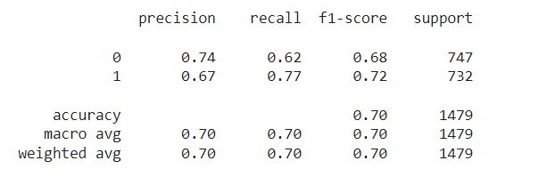
SVMs(Support Vector Machines)

Slide 13
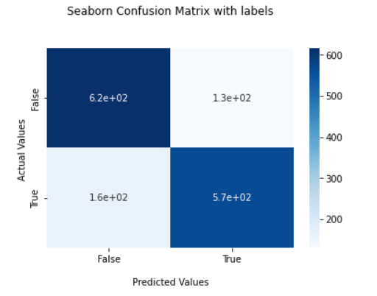

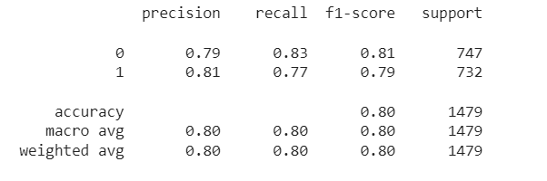
Decision Tree

Slide 14
Thank You!

